Slide 1

BNI CHAMPIONS

Slide 2
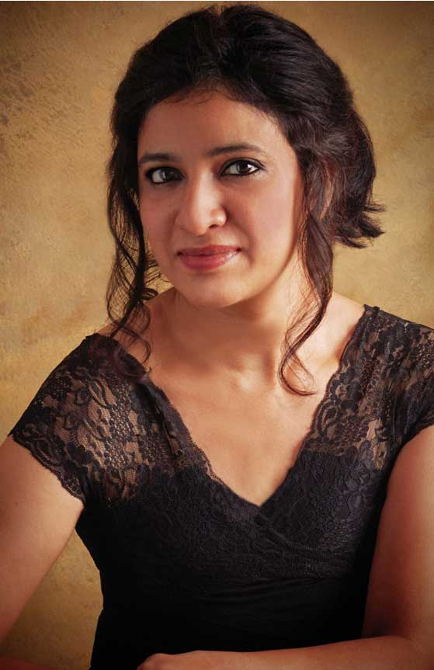

Meesha Vaz Meesha Vaz Fine Art Photography
Fashion & potrait Photography
www.meeshavaz.com

Slide 3
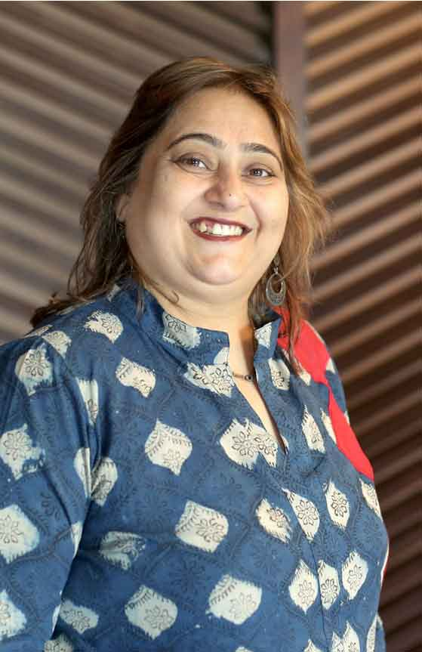
Rekha Kanakia Health Forever Clinic
Alternative Medicine
www.healthforeverclinic.in

Slide 4
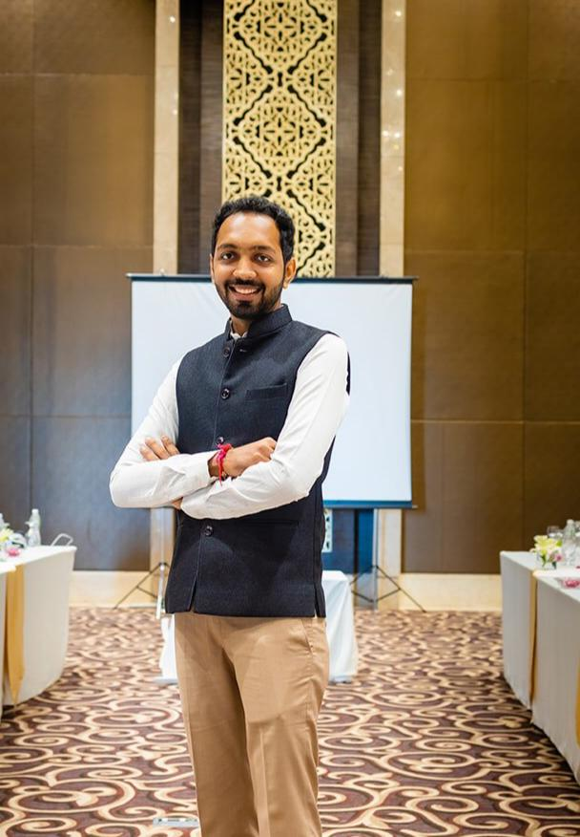
Mahek Satra Supreme Traders
Traders in Acralyic sheet Polycarbonate sheet PVC sheet Specialise in Leasurecutting on Acraylic sheets N fancy decorative name plate
+91-9664955633

Slide 5
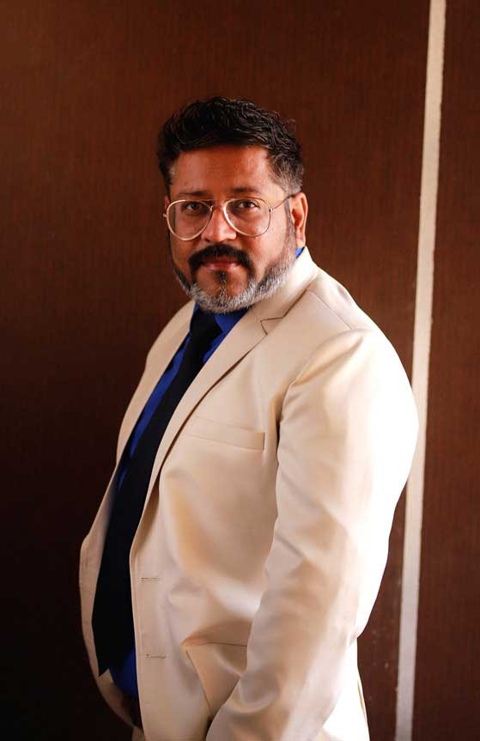
Vishal Ramaiya Fusion Designs
Artist painter
+91-9820257424

Slide 6
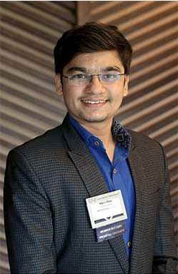
Marin Mota Marin Trading Company
Food Grain & Grocery Supplier
+91-9773396948

Slide 7
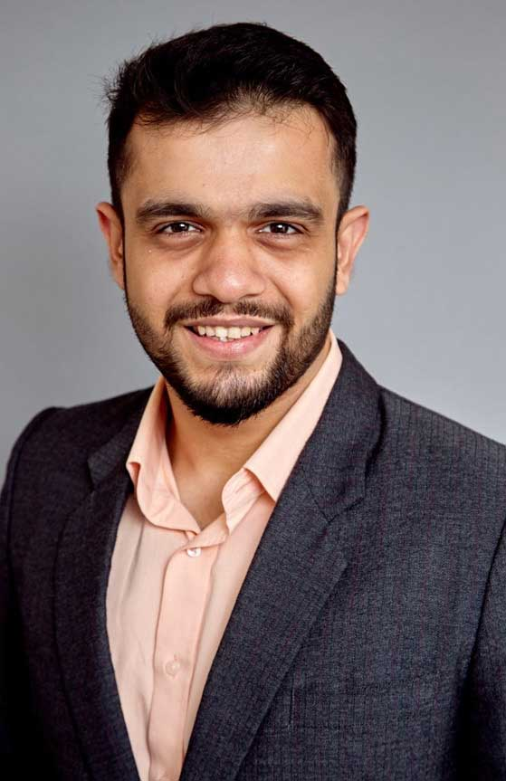
Nishant Shah LAC Relocations
International and Domestic Packers and Movers. Freight Forwarding with in-house Custom Clearance. Operating Since 1944. Networks in more than 150 countries. Cover all major Ports in India.
www.lacrelocations.in

Slide 8
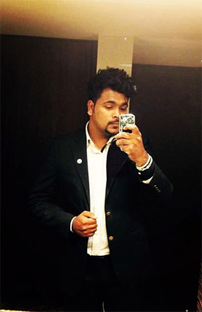
Harsh Sheth SHETH PROPERTIES
Residential Property Consultant. Operating Since 2000. Cover all major area in South Mumbai.
+91-9967999901

Slide 9
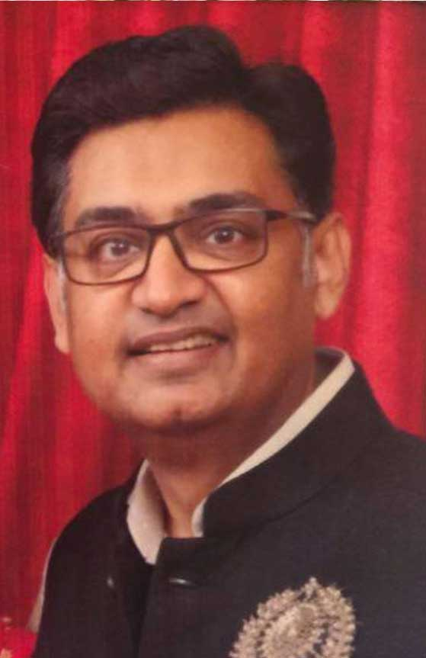
Abhi Jhaveri Urnish Jeweller
Jeweller - Jadau
www.urnishjewellers.com

Slide 10
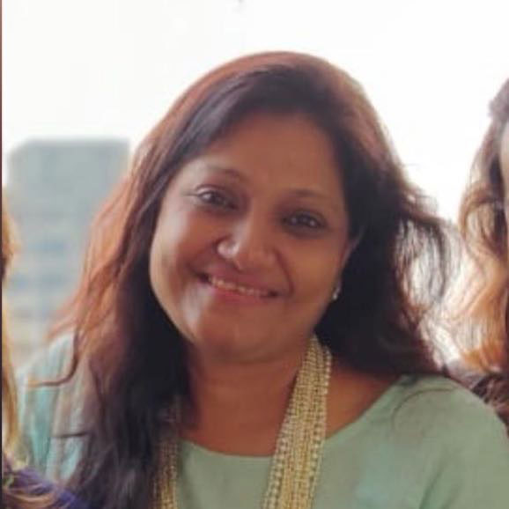
Niru Kanodia Food Culture
Caterer
www.timl.in

Slide 11
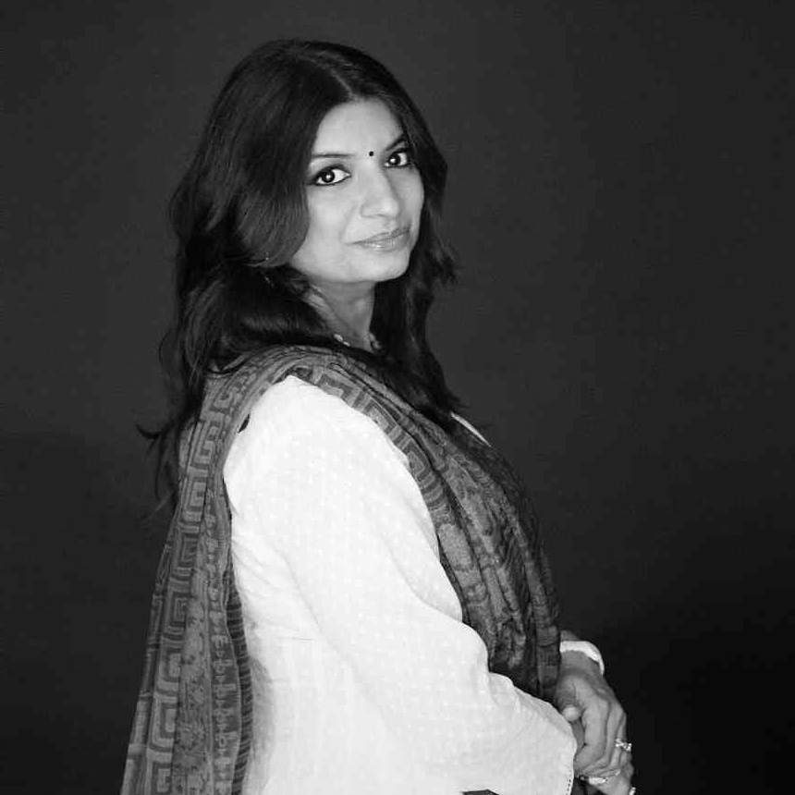
Ssarita Ketan Dagha Kristall Transforming Lives.
Internationallly Licensed Transformational Coach & Heal Your Life®️ Workshop Leader. USP: Employs Art therapy & Graphology Ensures your growth.
+91-9892567776

Slide 12
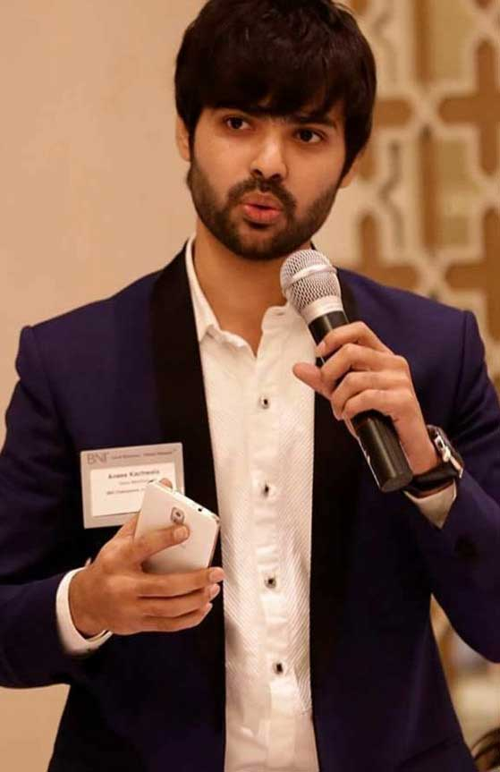
Anees Kachwala Juzer Traders
Glass Trader
+91-9769343388

Slide 13
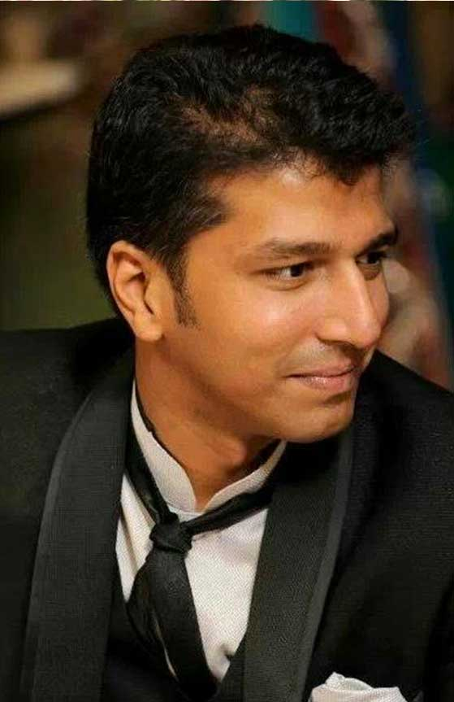
Aditya Bajaj Bon Evento
Wedding planners D-Day management Guest relations, hospitality & logistics - B2B/B2C Wedding carnivals - B2B/B2C
www.bonevento.com

Slide 14
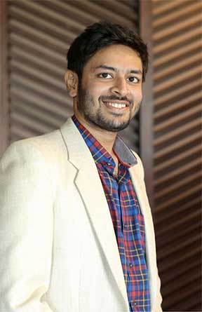
Kanhay Vviisharia Kalpavruksha
Printing & Packaging
+91-9820781133

Slide 15
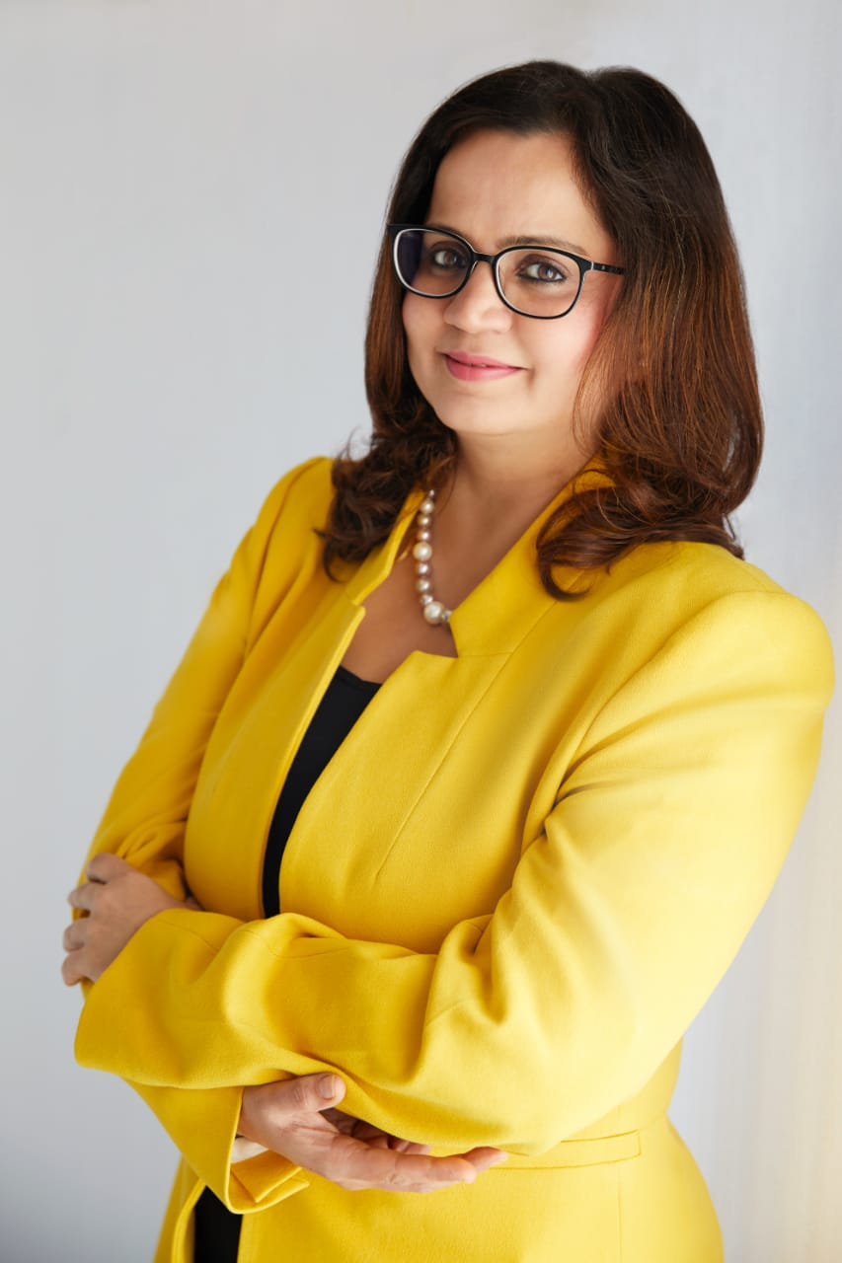
Dr-Divya Malhotra Numerology - Precise Solutions
Numerologist. we help an individual or companies through GST..YES GYAN OFSECRET. TALENT. COMPLETEED PH.D IN NUMEROLOGY.
www.numerologyprecise.com

Slide 16

Neha Chavan Neha Chavan Design Studio
Neha Chavan Design Studio specialises in Bridal and Festive Womens Wear. Retail Store based at Prabhadevi.
www.nehachavan.com

Slide 17
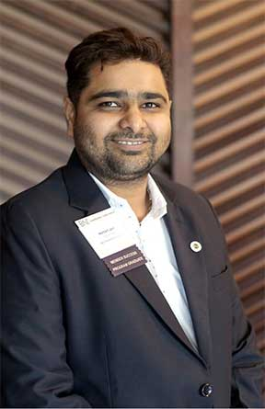
Hemant Jain Mayur Suvidha Travels Llp
Travel Agent - Specialised In Flight Tickets , Hotel Bookings , Packages & Many More. For Special Deals Please Contact Us.
www.mayursuvidhaa.com

Slide 18
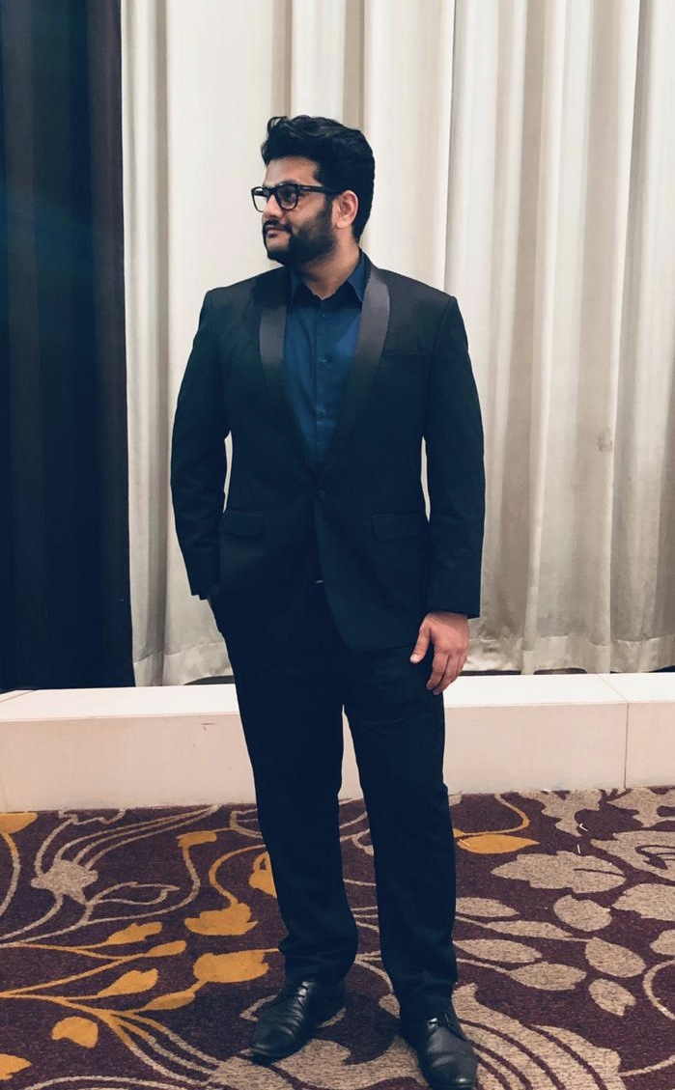
Sahil Sawant Modern Opticians
Addressing all vision care needs since 1967
modernopticians.in

Slide 19
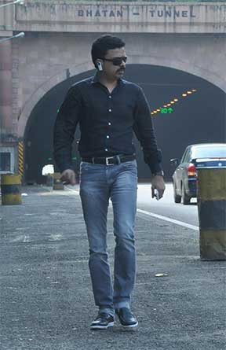
Madhuusudan M Rao M.N.Rao Bespoke Tailors
Bespoke Tailer
www.mnrao.com

Slide 20
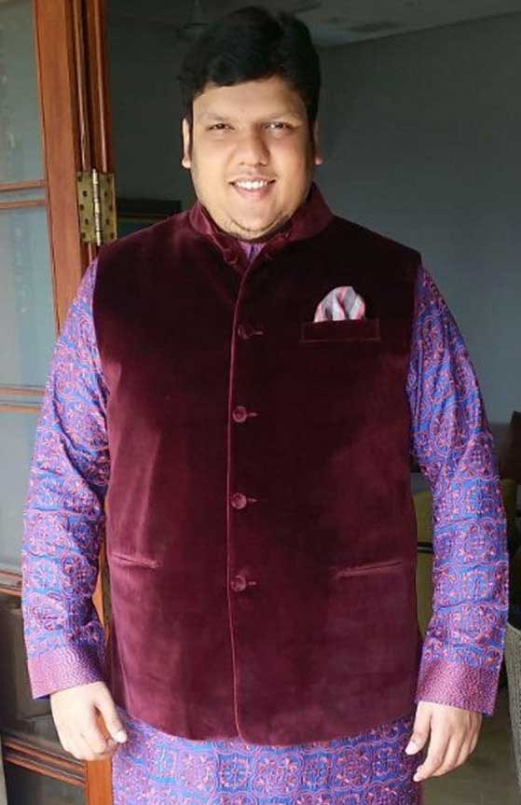
Sharvil Bhagat Vinay Construction
Turnkey Interior Solutions across India for 35yrs Services like Capentary, Electrical, Civil & Plumbing, Paint & Polish etc We have made Houses,Villas,Offices,BPO,Banks,Hotels, Gymkhana,CricketStadium
www.vinayworld.com

Slide 21
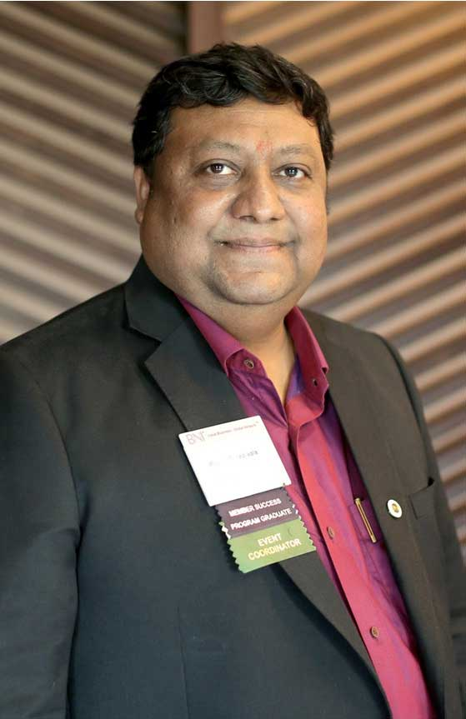
Piyush Ganediwala Concept Equipments
Digital Security Systems like CCTV. Access Control, Fire Alarm, Fire Fighting, Home Automation and Pro Audio. Have done a wide variety of projects from 500 Sq.ft to 5 Lakh Sq. Ft.
www.conceptequipments.com

Slide 22
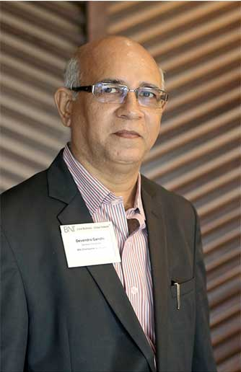
Devendra Gandhi DACR Insurance
GENERAL INSURANCE Consultant approved by IRDAI.Travel Insurance, Group& individual Mediclaim & Personal Accident Insurance, Fire Insurance for Office, Shops, Godowns, Residence&Bungalows with content
www.insurancemumbai.in

Slide 23
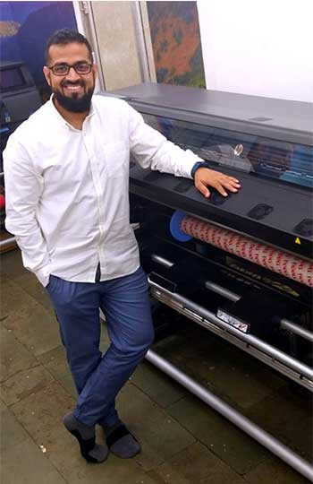
Moiz Kopti Printology Concept
Digital wide format printing
www.printologyconcept.com

Slide 24
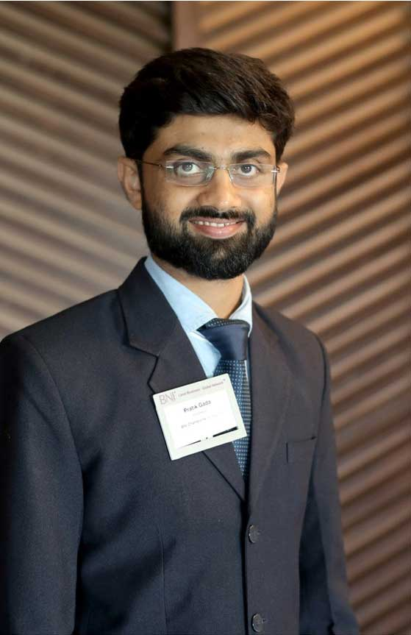
Pratik Gada Jyoti Hardware Stores, Dadar (W)
Fancy furniture hardware, Hettich, Haffele, Godrej, Enox, Ozone, Dorma, Ladders, Cloth drying stands
+91-8080301301

Slide 25
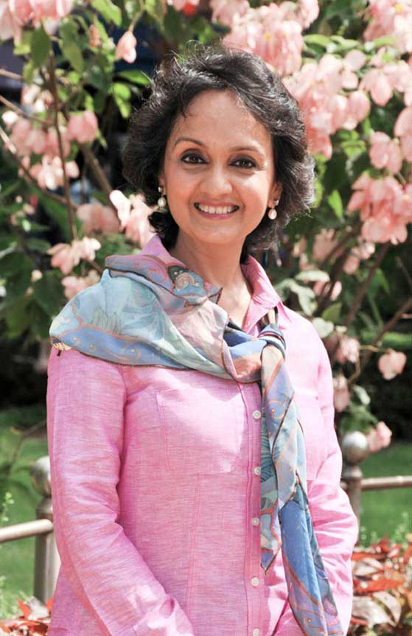
Nupur Rastogi Nupur Rastogi Design
Commercial Interior Design
www.nupurrastogidesign.com

Slide 26

Deepaa Conttractor RED Tours
Intnl Tour Operators HQ London Mumbai off Marine Lines. Fixed Group Departures West Europe. Customised Tours. Veg/Jain food served.Tickets,visa forex
www.redtours.co.uk

Slide 27
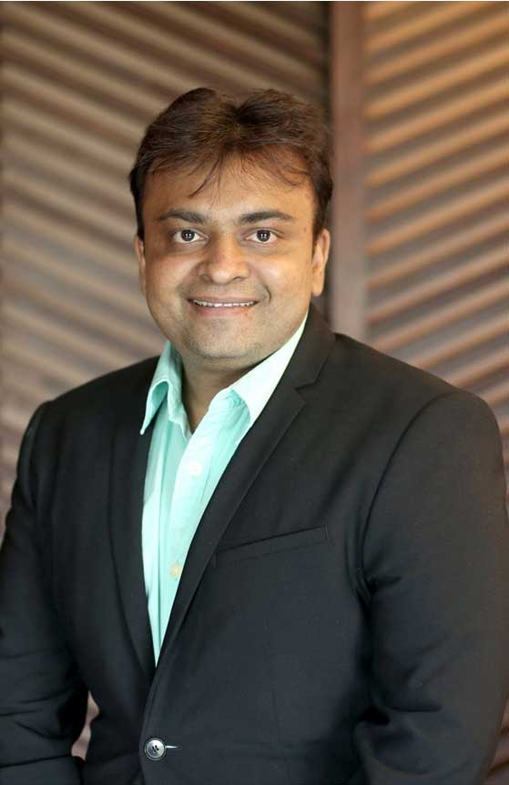
Nishit Mehta Abhay Ply Centre
Authorized dealers of plywood brands like Anchor 72 green century Kenwood Magnus. with 80 years of Goodwill and experience we also deal into all types of wood veneers and laminates
Nil

Slide 28
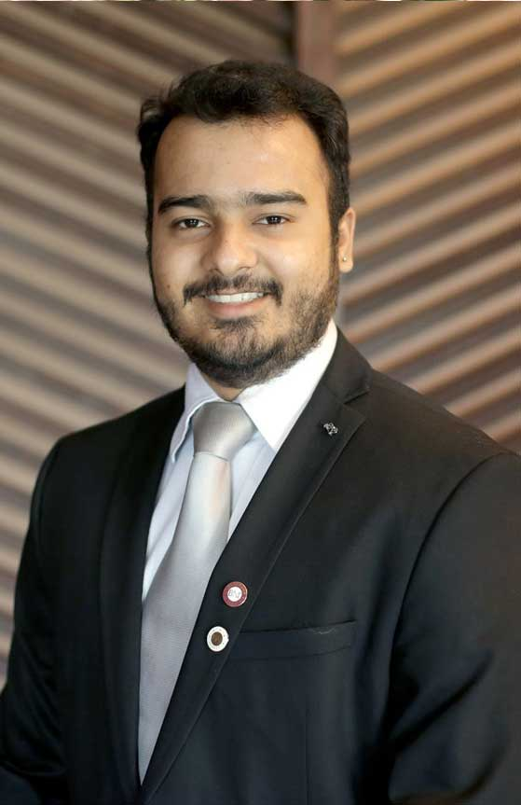
Abhishek Modi Dr. Teeth Implants and Aesthetic Center
Dentist
www.drteeth.co

Slide 29
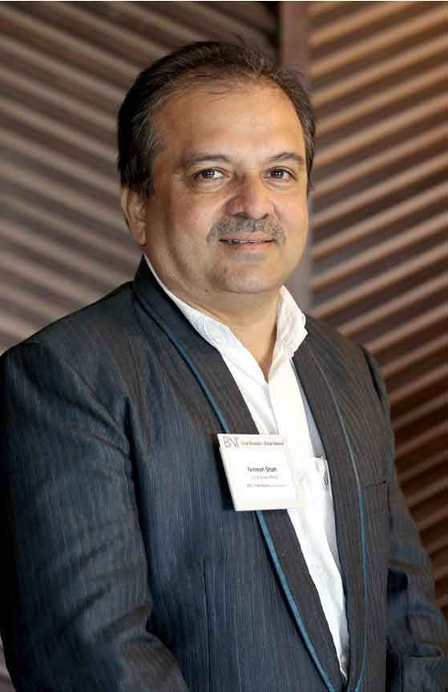
Nimesh Shah M/S. Kwik Travels Netwwork
Automotive Rental
www.kwiktravels.com

Slide 30
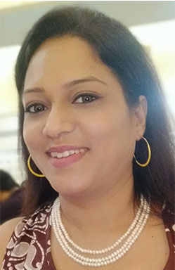
Mamta Bhatt Mamta Bhatt Bridal's World
Make Up Artist
www.mamtabhatt.in

Slide 31
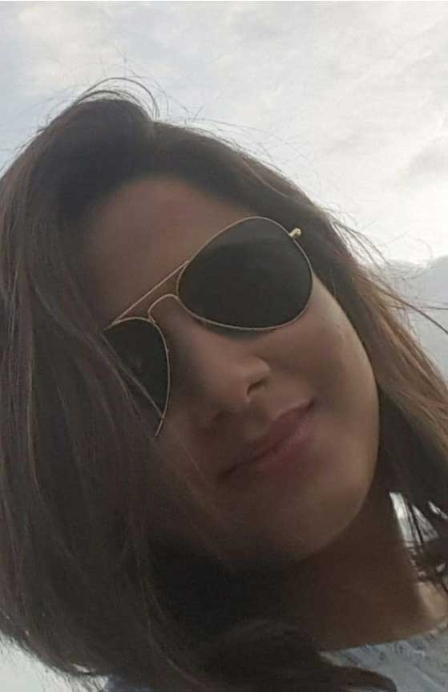
Sonam Jain Thanksgiving Patisserie and Confectionery
Bulk Manufacturer for eggfree bakes, cakes and Confections. Expertise in gifting hampers, wedding cakes, customised cakes. Cakes, cookies, macrons, breads, Biscotti, crostinis,verrines, desserts etc
www.thanksgivingbakeshop.com

Slide 32
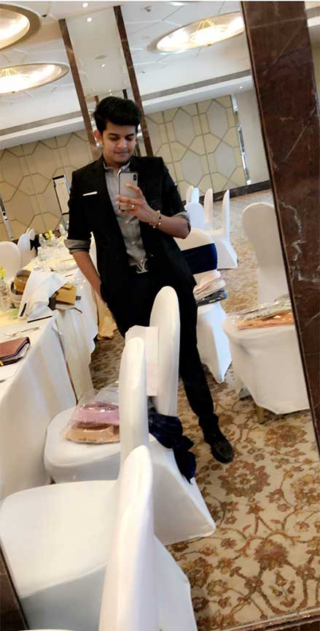
Nirmit Vikamsey Vasant Creative
Exhibition Stall Design Company with a Prolific track record of over 2 decades,600+ stall designs, Serving major Indian brands across diverse industries. With Pan India and International Presence .
www.vasant.in

Slide 33
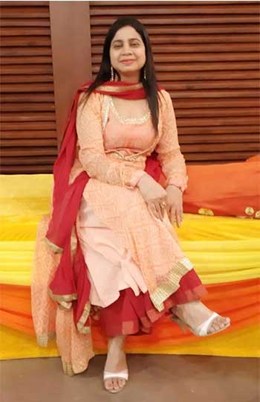
Neeta Hajiyani Uniform Junction
School Uniform Manufacturer
+91-9820717769

Slide 34
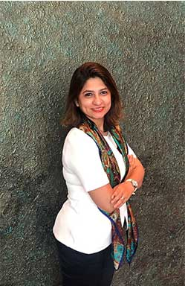
Mamta Thakkar The Implementers
Graphic Designer. We are a ONE-STOP-SHOP for your complete design & communication requirements. We can design creatives, create videos & manage content. Shall look forward to get in touch. Thanks
www.the-implementers.com

Slide 35
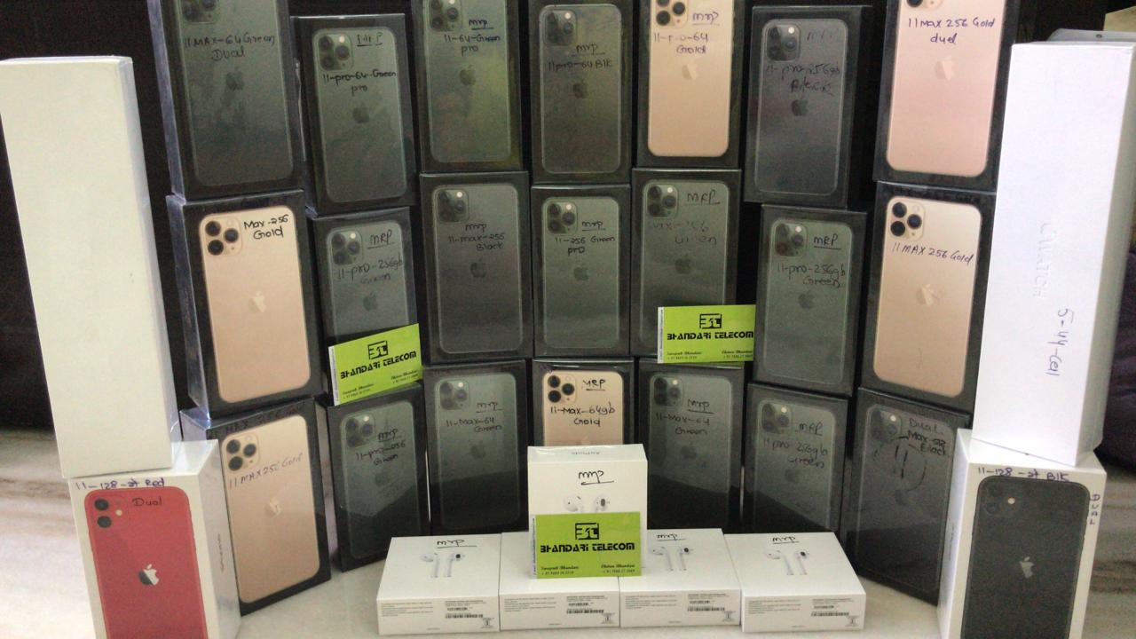
Swapnik Bhandari Bhandari Telecom
Dealers in all brands of Mobile Phones specialising in Apple iPhones, iPads, Airpods,Watches . USP -On time delivery across pan India -Best Pricing
+91-9869745739

Slide 36
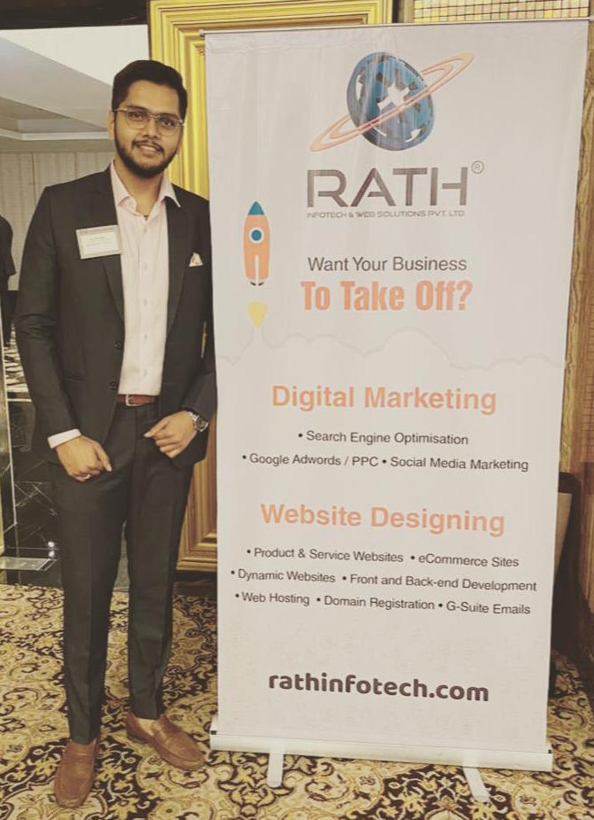
Sumeet Mehta Rath Infotech & Web Solutions Pvt Ltd
- Web Designing - Web Development - SEO - Social Media - Paid Ads - Domain / Hosting - GSuite
www.rathinfotech.com

Slide 37
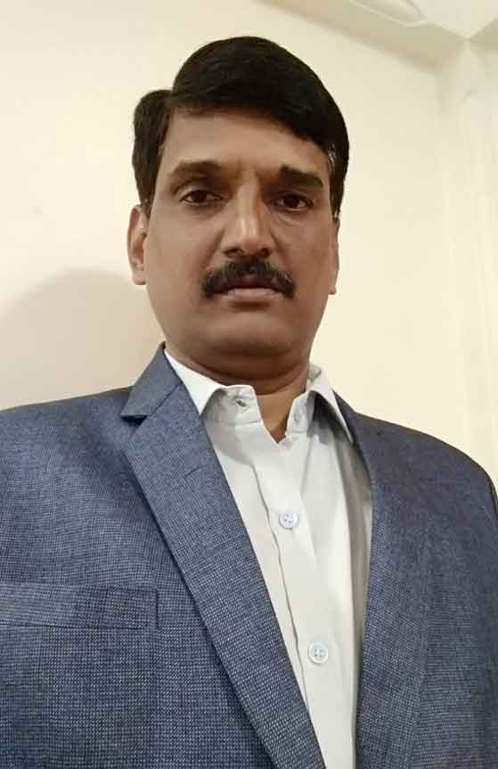
Nilesh Tupe HRC
Data Recovery
+91-9321287758

Slide 38
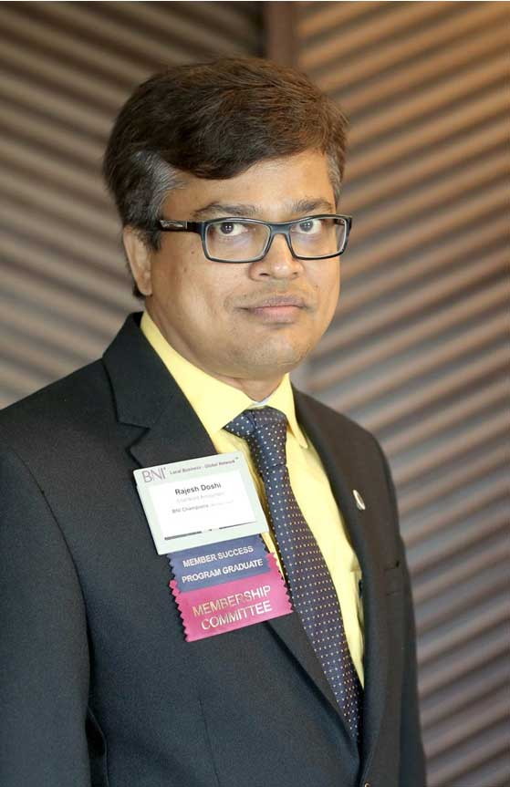
Rajesh Doshi M C Doshi & Co
Chartered Accountant - Direct Taxes & Audits
www.mcdoshi.com

Slide 39
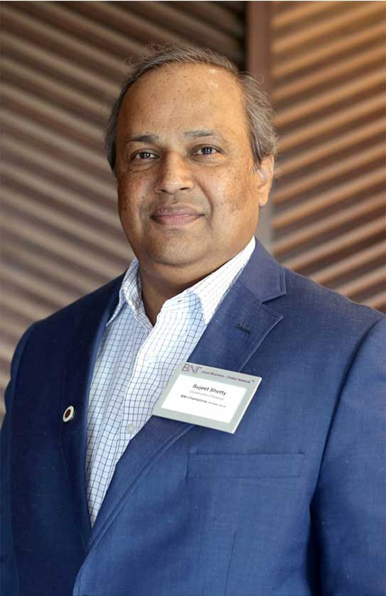
Sujeet Shetty Panel Source Llp
Plywood Manufacturer
www.panelsource.in

Slide 40
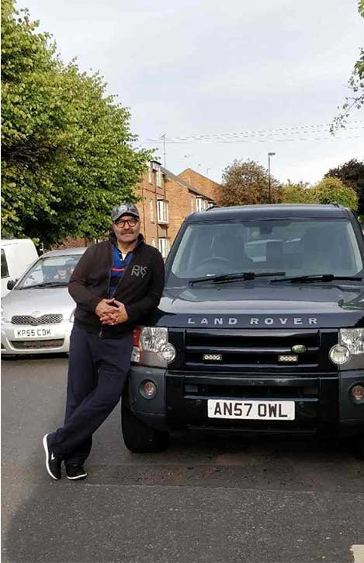
Sanjay Chugh Smooth Drive
Car Dealer
www.autoselect.in

Slide 41
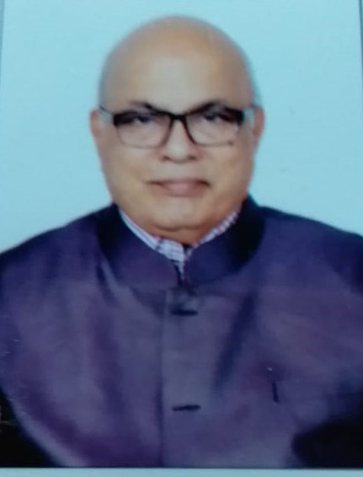
Ramesh Bhat Ramesh Bhat & Associates
Financial Services
+91-9322218525

Slide 42
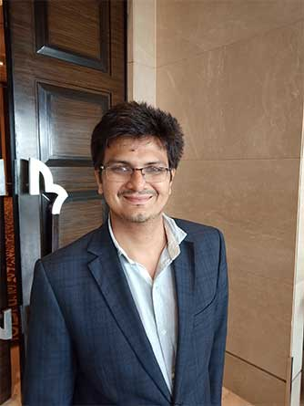
Fenil Bhimani H N O Mattresses
Mattresses Manufacturer
www.hnofurnishing.com

Slide 43
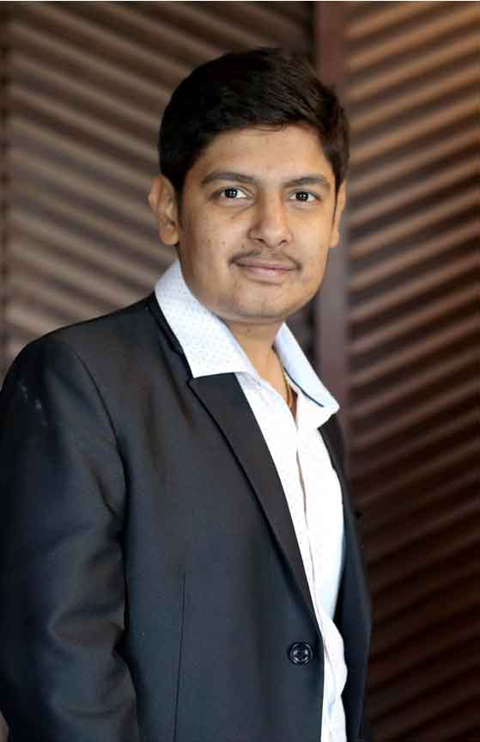
Rushabh Parekh K Jivraj & Sons
Exclusive importer for designer tiles from Spain & turkey
+91-9819037800

Slide 44
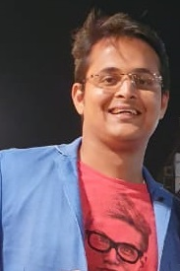
Monish Shah Monish D Shah & Associates, Chartered Accountants
Goods & Services Tax Consultant U.S.P. - Timely Compliance, Updated and Practical Solutions Success story - identified additional gst input credit worth 26 lacs for a client.
www.mdsa.in

Slide 45
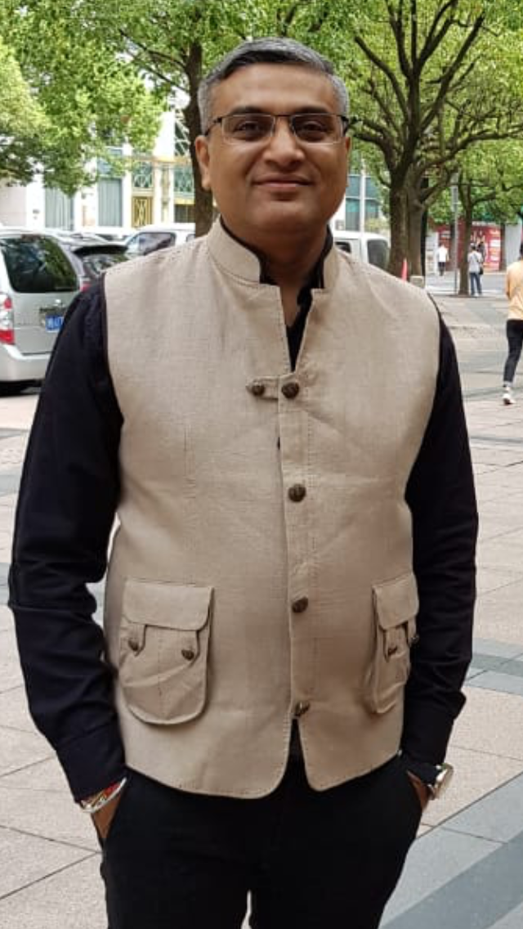
Nilesh Gala TREZURE
Readymade Furniture
www.trezure.in

Slide 46
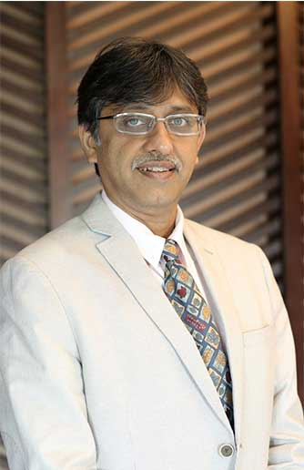
Devang Sarvaiya Herrlich Chemicon
Tileskin(0.2mm laminated sheet, Waterproof , Not a VINYL , Instant Makeover ) For Any Surface - Do not Break it Just Skin it. Telki ( Coasters, Trivets , Placemats , Rugs )
www.herrlich.in

Slide 47
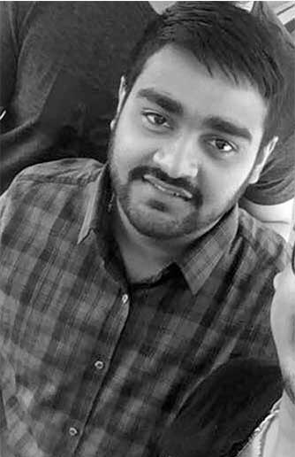
Dhanesh Mehta M M Metatrade Pvt. Ltd.
Metal Trading
www.mmmetatrade.com

Slide 48
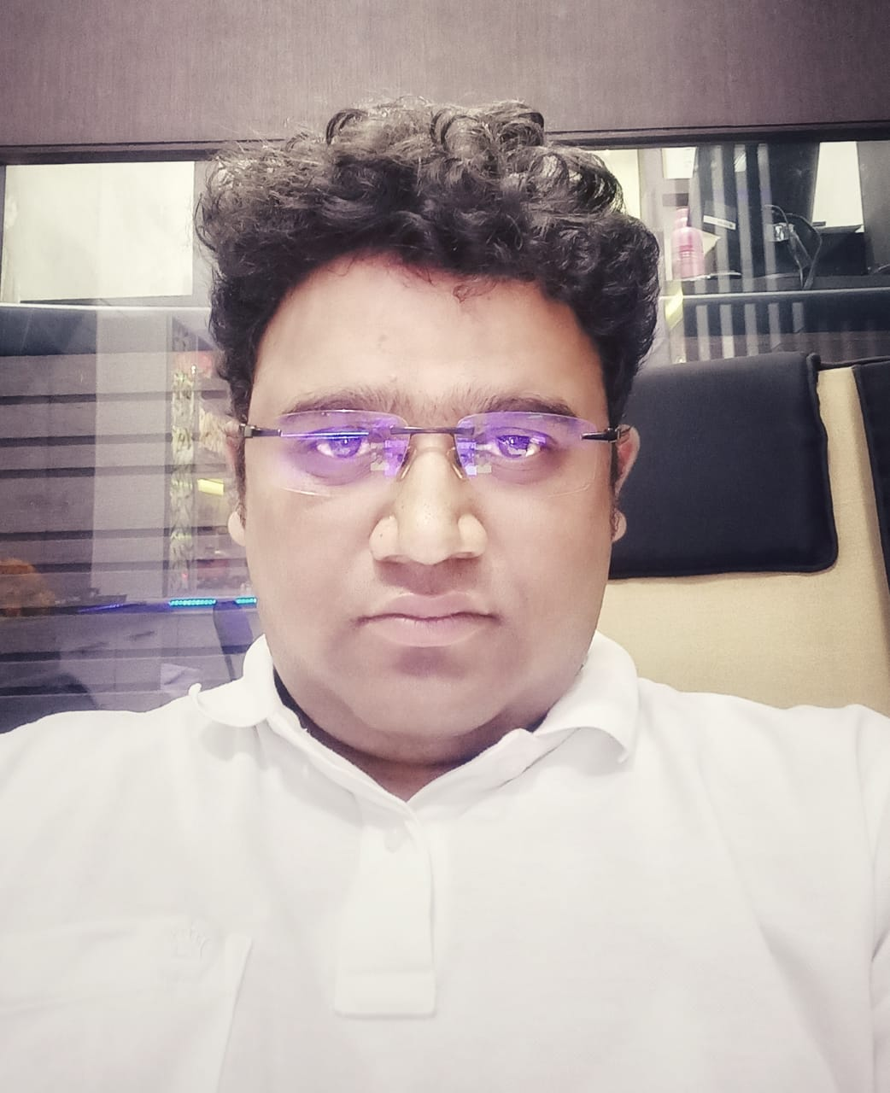
Akhilesh Agrwal Mahalaxmi Companies
Modular kitchens, Built-in-appliances. All branded and German hardware. Products also available on 0% interest EMI.
www.inavitmodutech.com

Slide 49
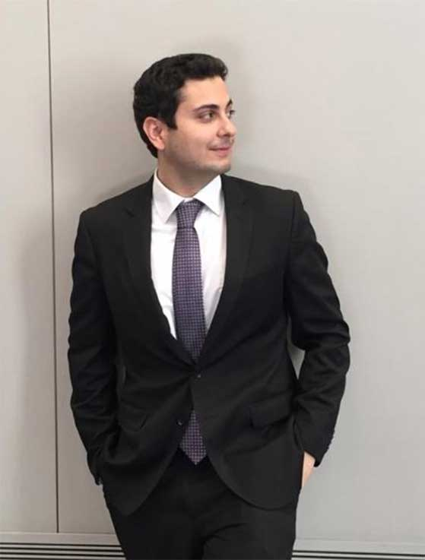
Danesh Mehta M Mulla Associates
Lawyer. Handles Real Estate transactions, Succession planning, Commercial contracts, Business agreements. Member of the Bar Council of Maharashtra and South Asian Bar Association, Chicago.
www.mmassociates.in

Slide 50
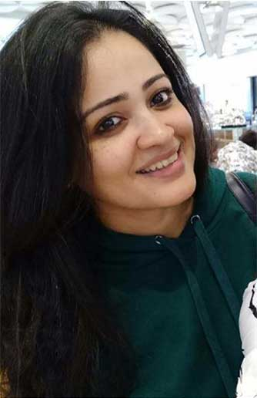
Dipti Shah All That Glitters
Gold jewellery with Swaroskis At our opera house studio, we design and curate your dream designs at pocket friendly prices. Our jewellery range is 10000 for a pendant to 3 lacs for a bridal set.
www.allthatglitters.in

Slide 51
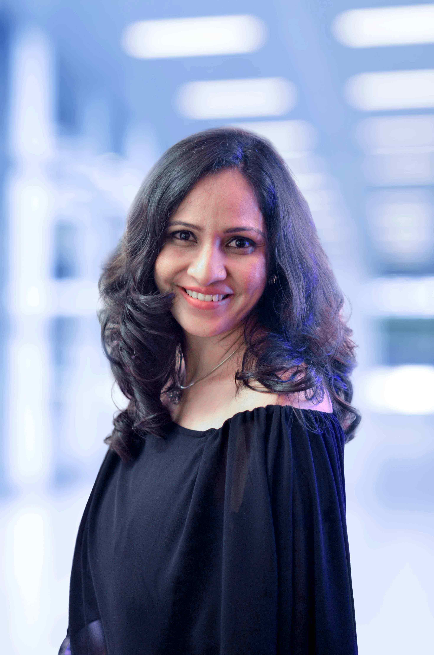
Nisreen Kachwala Asian Prelam Industries Pvt Ltd
Laminated Panel Products
www.asianprelam.com

Slide 52
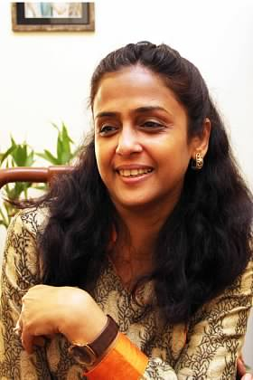
Vidhi Maheshwari Kavya Creations
Favors,Trousseau Packing,Shagun Envelopes,Coin Gifting,Invite/Return Gifts,Varmalas, Platters,T lights,Home Decor Items. Corporate Invites/Returns.
www.kavyacreations.com

Slide 53
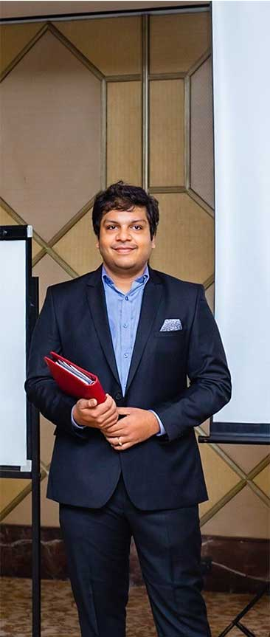
Devang Gala DAFTER
Bag Manufacturer
www.dafterluggage.com

Slide 54

Hitesh Bhanushali Global Innovest
Stock Market Broker - Technical & Fundamental analysis for Direct Stock Trading & Investments
www.globalinnovest.com

Slide 55

Raksha Jain Co-founder of RJLEGAL having offices in Mumbai & Daman
Corporate Lawyer (Energy Laws & Intellectual Property Laws) providing advisory, consultancy and legal documentation services.
www.rjlegal.in

Slide 56

Swaritha Chennapagada Swai Tales
Wedding & Event Photographer - One stop Shop for Photography & Cinematography services to cherish your memories forever. - USP- Story telling style of photography and videography .
www.swaitales.in

Slide 57

Ashish Agrawal Worldwide Gem Exports
Natural Coloured Gemstone(Precious & Semi Precious), Beads & Pearls
www.semibeads.co.in

Slide 58

Suresh Jathar Harsh Consultancy
Life Insurance
+91-9869030677

Slide 59

Ameesha Art of Eloquence
Art Curator
+91-9520046702

Slide 60

Mayur Heroor Mayur Heroor Associates
Residential Interior Designer
+91-9920371626

Slide 61

Niraj Jain Kangen Alkaline Water
Distributors for Kangen water machines from Japan. The worlds healthiest drinking water device. Clients like indian cricket team players, top doctors and many celebrities.
niraj2210.kangendemo.com

Slide 62

Pranit Jain Furi Fashions Inc.
Shirt Manufacturer
+91-9820048801

Slide 63

Shenki Jain V. K. Jewels
Gold Jewellry
www.vkjewels.in

Slide 64

Murtuza K Bizzy Baby Media LLP
Animation
+91-9833630689

Slide 65
LATE COMERS

Slide 66
SUBSTITUTES

Slide 67
BNI CHAMPIONS

